Slide 1





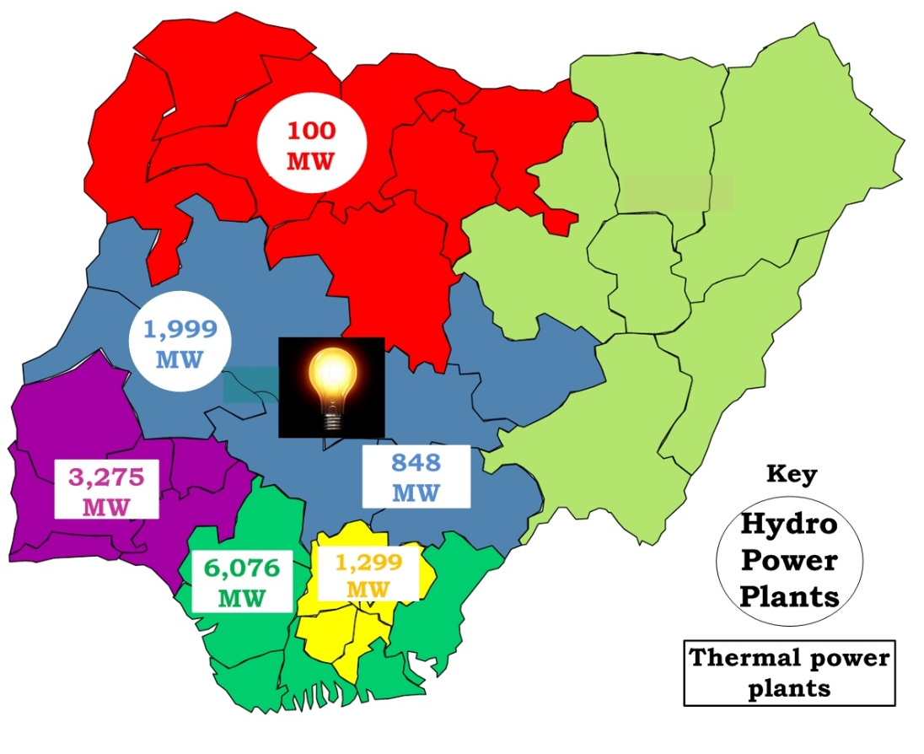
Supported by:
AEIC Poster Title
Name:
Affiliation :
Proposed Solution
Posters should be considered a snapshot of your work intended to engage readers in a dialog about the work, or, if you are not present, to be a summary that will encourage the reader to want to learn more.
The size of the poster template is 594 x 841 mm, portrait format. Do not alter the paper size or orientation. All poster are expected to be similar in size and outline, although there may be some variation in the colour schemes.
.Photographs should be a minimum of 148 x 210 mm. Material should be displayed in logical sequence.
Economic feasibility/Proposed Business Model
Everything on the poster should help convey the message. The text must conform to the high-quality scientific reporting: clarity, precision of expression, and economy of words. The latter is particularly important for posters due to their space limitations.
Displaying information on a poster gives you an opportunity to represent your data in an interesting and eye-catching way. Think about how your display can be enhanced through the use of illustrations, tables, charts or photographs. The inclusion of one carefully chosen image can be a very powerful way of drawing people’s attention to your poster.
Technical Design
Avoid overcrowding figures and cramming too many numbers into tables. Legends and titles should accompany all figures, tables, photographs, etc. in order to allow their immediate identification. Poster material should be well labelled and legible from a distance of 10 to 15 feet. The title should be the same as the title submitted with the abstract and appear in boldface at the top. Make sure the main points can be read at eye level. The purpose of poster presentation is to educate others about your research finding. It is important to communicate the research question you addressed.
Timeline for developing prototype/trial
Most word-processing packages give you the option of aligning your text in different ways on the page; the main choices are left, right, centre and justified. Avoid mixing alignments as this can look very awkward. Left aligned is the easiest to read, particularly when using large type.
Use phrases instead of sentences as much as possible
Use appropriate grammar and spelling
Briefly provide your results and findings in a clear and concise bullet points or easy to read tables. Highlight the most important ? Interesting finding of your work and provide explanations.
Budget & Target User/Market/Scale
Provide a summary of the key information you wish to communicate to the readers. Provide the relevance of your findings for practice and future research studies.
References
[1] IEA 2014. Africa Energy Outlook : A focus on energy prospects in Sub-saharan Africa [Online]. Available: https://www.iea.org/publications/freepublications/publication/WEO2014_AfricaEnergyOutlook.pdf (Reference to a report)
[2] Van der Geer J, Hanraads JAJ, Lupton RA. The art of writing a scientific article. J Sci Commun 2000;163:51–9.
[3] Strunk Jr W, White EB. The elements of style. 3rd ed. New York: Macmillan; 1979.
Fig. 1: Regional distribution of hydro and thermal power station in Nigeria in 2017
Acknowledgements
Briefly acknowledge any funding source or technical support
10th AFRICA ENERGY INNOVATION CHALLENGE → Nigeria Energy Forum. DAY2 – Thurs. 20TH Nov. 2025 (Virtual)

